Slide 1
FINAL CODE
REVIEW
AnChain.ai Bitcoin Price Prediction
Notes:
Speaker: Chris

Slide 2
Overview
00
Notes:
Speaker: Chris

Slide 3
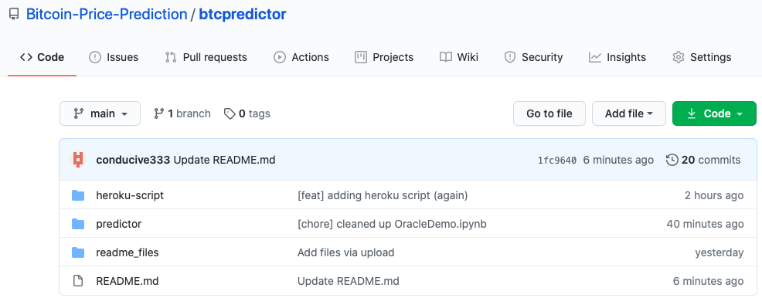
Github Repository
https://github.com/Bitcoin-Price-Prediction/btcpredictor
Notes:
Speaker: Chris

Slide 4



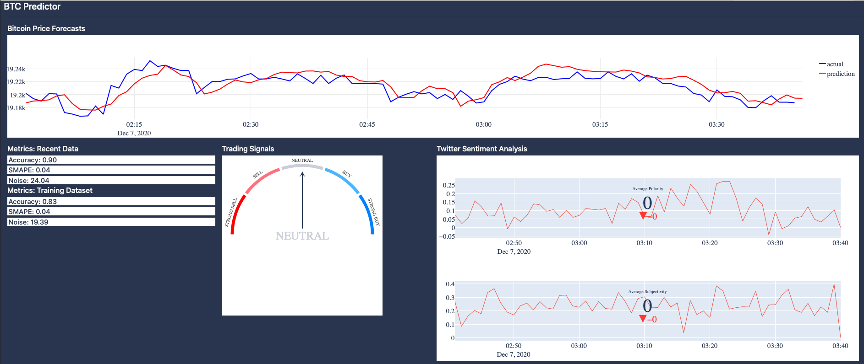


System Architecture
Data Sources
Trading Signal
Module
Datastore
Module
Tweet
Module
Technical
Indicator
Analyzer
Market
Data
Module
Predictor
Module
Dashboard
24/7 Data
Collector
DB
LSTM
Model
DB
Module
Notes:
Speaker: Chris

Slide 5
logger
01
Data Sources
24/7 Data
Collector
DB
Notes:
Speaker: Chris

Slide 6
Folder Hierarchy
Main Directory
script.py
util
24/7 Data Collector Code
BTC Predictor Code
database.py
helpers.py
logger.py
reporter.py
news_logger.py
tckr_logger.py
trxn_logger.py
Notes:
Speaker: Chris

Slide 7
How does this work?
We have two databases on Google Firebase:
Our real time database only holds data for the current day
Our long-term database holds data from previous days
We use database.py to connect to both of them
Each logger collects a specific type of data:
news_logger.py ⇒ News data (every 5 minutes)
tckr_logger.py ⇒ BTC price (every 5 seconds)
trxn_logger.py ⇒ Transaction data (daily)
During the day, script.py uses each logger to push data to the real time database
At the end of the day, script.py moves the data in the real time database to the long-term database
Finally, reporter.py sends an email summarizing the data collected and any failures that occurred
The script is robust to ALL API failures - if an error is raised, the script will record the failure and continue logging data
Notes:
Speaker: Chris
So now let’s understand how all these files work together
There’s two databases you need to be concerned about - a real time one and a long-term one
The database.py file is as you might have guessed contains the code that establishes a connection to the databases
We built three loggers and each one is responsible for collecting and storing one type of data
During the day the realtime database is filled with the data collected by the loggers and at the end of the day the data is flushed to long term storage
Lastly, an email is sent to me directly after the data is stored and it reports what happened for the day
One benefit of doing it this way is scalability - so if you wanted to you could include more loggers quite easily
One key design feature we have here is that we made the script robust to API failures. Whenever an error is encountered it logs the failure and keeps going. This means we don’t need to constantly restart it every time something bad happens - it can just run infinitely and we could check in every now and then

Slide 8
Things You Should Know
We have two databases on Google Firebase:
Our real time database only holds data for the current day
Our long-term database holds data from previous days
We use database.py to connect to both of them
The script is robust to ALL API failures - if an error is raised, the script will record the failure and continue logging data

Slide 9
How does the logger work?
Each logger collects a specific type of data:
news_logger.py ⇒ News data (every 5 minutes)
tckr_logger.py ⇒ BTC price (every 5 seconds)
trxn_logger.py ⇒ Transaction data (daily)
During the day, script.py uses each logger to push data to the real time database
At the end of the day, script.py moves the data in the real time database to the long-term database
Finally, reporter.py sends an email summarizing the data collected and any failures that occurred

Slide 10
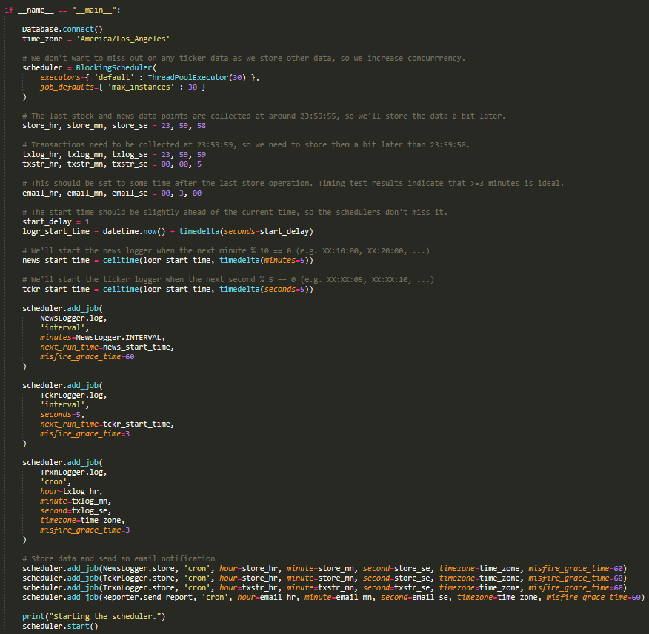
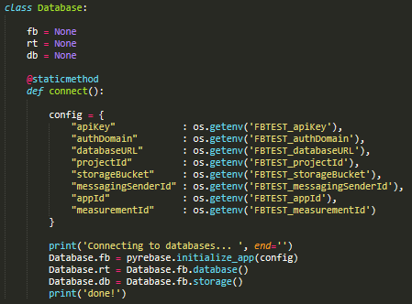
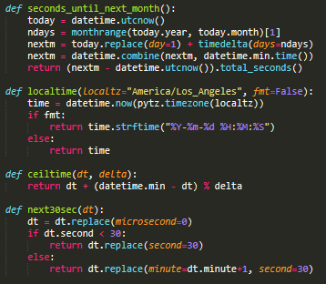
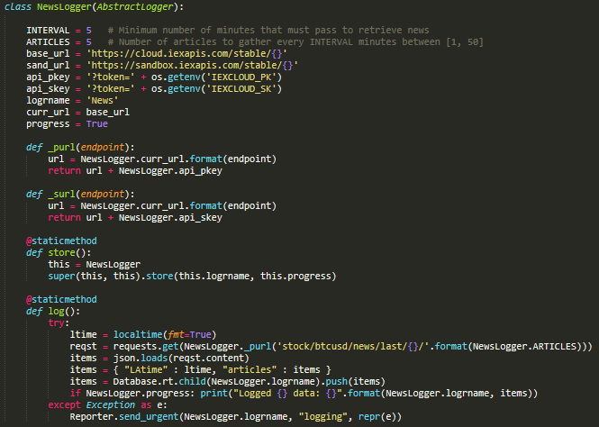
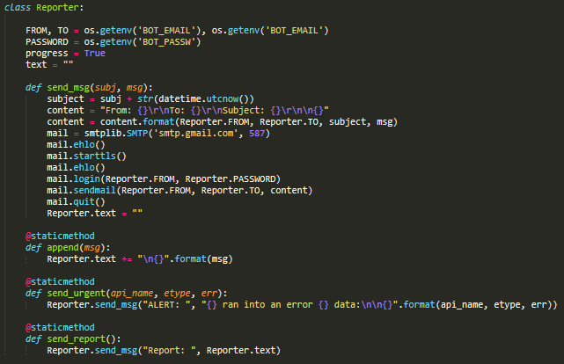
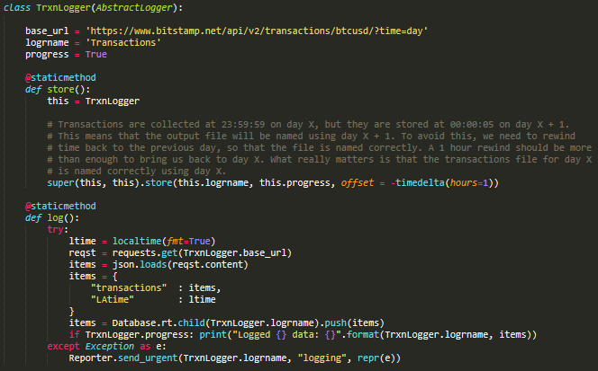
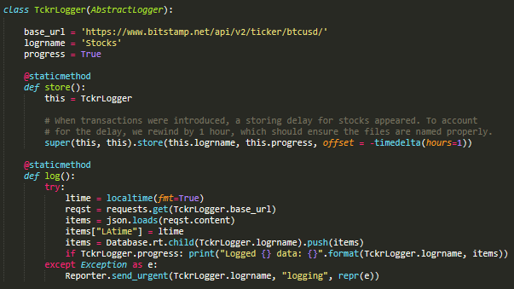
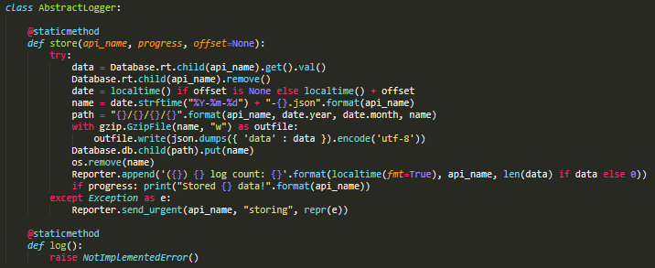
Logger Directory
Current File
Code Samples
tckr_logger.py
reporter.py
database.py
script.py
trxn_logger.py
helpers.py
logger.py
news_logger.py
Notes:
Speaker: Chris
Main points:
Now that you have a sense of how it works I’ll show you the code for each of the files in this directory and point out some things to take note of - I’m not going to spend too much time here so if there’s a particular file you see that you’d like to take a better look at feel free to stop me
Various optimizations performed to make full use of free services
Follows security principles - developer keys hidden as environment variables
Class inheritance reduces A LOT of the code
Naming conventions upheld: constants all uppercase, private method names are preceded with an underscore

Slide 11
System Architecture
Data Sources
Trading Signal
Module
Datastore
Module
Tweet
Module
Technical
Indicator
Analyzer
Market
Data
Module
Predictor
Module
Dashboard
24/7 Data
Collector
DB
LSTM
Model
DB
Module
Notes:
Speaker: Chris

Slide 12
datastore
02
Datastore
Module
Tweet
Module
Market
Data
Module
DB
Module
Notes:
Speaker: Chris

Slide 13
Folder Hierarchy
Main Directory
BTC Predictor Directory
24/7 Data Collector Code
BTC Predictor Code
models
datastore
sti
demos
Notes:
Speaker: Chris

Slide 14
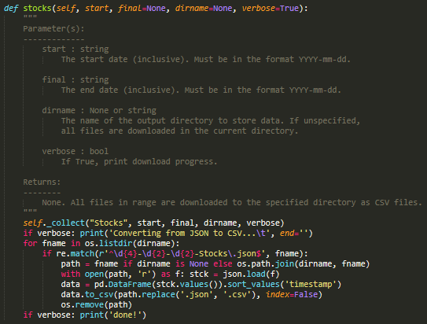
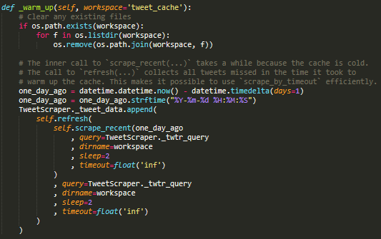
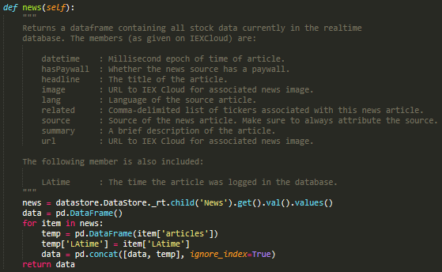
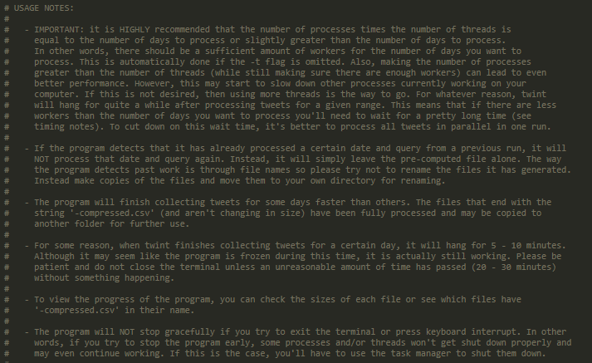
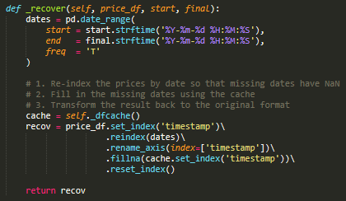
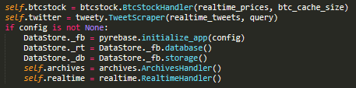
Datastore Directory
Files
Code Samples
btcstock.py
tweety.py
datastore.py
realtime.py
archives.py
Notes:
Speaker: Chris
Main points:
Like last time I’ll briefly show you some of the code and point out some things to take note of
Files are split up into logical units instead of being clumped into one file and datastore.py connects all these units together
btcstock.py contains a class that provides easier access to minute-by-minute OHLCV Bitcoin data from Bitstamp. The code snippet here shows one function involved in our data recovery mechanism. Notice that long lines are broken up into several lines, and comments fully describe what’s happening in the code
Next we have tweety.py and this contains a class with several methods that allow for fast tweet scraping using twint. We built a tweet cache to help us get real time tweets for the dashboard and the code on the right shows a glimpse of how we warm up the cache. Notice that at the very top the code cleans up after itself when necessary and for more complicated calls we split up the lines and add comments as necessary
Another thing that’s worth mentioning is that ALL public methods are fully documented as shown here
realtime.py is used to get the data from the real time database described before - notice that the output of the function is described in depth to avoid any confusion
Finally we have archives.py, which is used to get data from the long-term database. Note that the types of each parameter are specified and a description of each parameter is also included

Slide 15
Key Design Features
tweety.py
btcstock.py
realtime.py & archives.py
- Multithreaded
tweet scraper
- Real-time cache
- Two modes:
- Historical
- Real time
- Data recovery
algorithm
- Real-time cache
- Two modes:
- Historical
- Real time
- Simple interface
- Easily scalable
- Seamlessly
interacts with
Firebase
Notes:
Speaker: Chris
Now that you’ve seen the code, I’ll move onto some of the design features. I listed the top ones here for reference, but the one I’ll mainly focus on is the tweet scraper in tweety.py bc it is one of the more interesting ones to talk about
The reason we built this was because we needed to collect over 2+ years worth of tweets for backtesting
The problem is that the ordinary Twitter API only gives you ~500 tweets a month for free. Now to put that into perspective our final ML model uses ~20,000 tweets for training, so we’d need to create 40 free developer accounts just to have access to that volume of tweets - so using the Twitter API was just not going to cut it
Fortunately, Michela did some amazing research to solve this problem and found a module named twint
And we thought that would be the end of it. However, as fate would have it scraping even just a few months worth of tweets with this library took several days and on top of that, once we had the data collected we needed to do a second pass over it and sort the tweets into organized files - and take our word for it that is not very fun to do!
So to handle both of these problems, we created our own script that uses multiprocessing and multithreading to cut down on the time. We also made it so the data was formatted neatly as we collected it so it would only require one pass
With this change, we managed to reduce tweet collection time from several days to ~20 minutes and managed to stay on track for the rest of the semester so this was definitely one of the main achievements we were happy about

Slide 16
System Architecture
Data Sources
Trading Signal
Module
Datastore
Module
Tweet
Module
Technical
Indicator
Analyzer
Market
Data
Module
Predictor
Module
Dashboard
24/7 Data
Collector
DB
LSTM
Model
DB
Module
Notes:
Speaker: Chris

Slide 17
models
03
Predictor
Module
LSTM
Model
Notes:
Speaker: Chris

Slide 18
Folder Hierarchy
Main Directory
BTC Predictor Directory
24/7 Data Collector Code
BTC Predictor Code
models
datastore
sti
demos
Notes:
Speaker: Chris

Slide 19
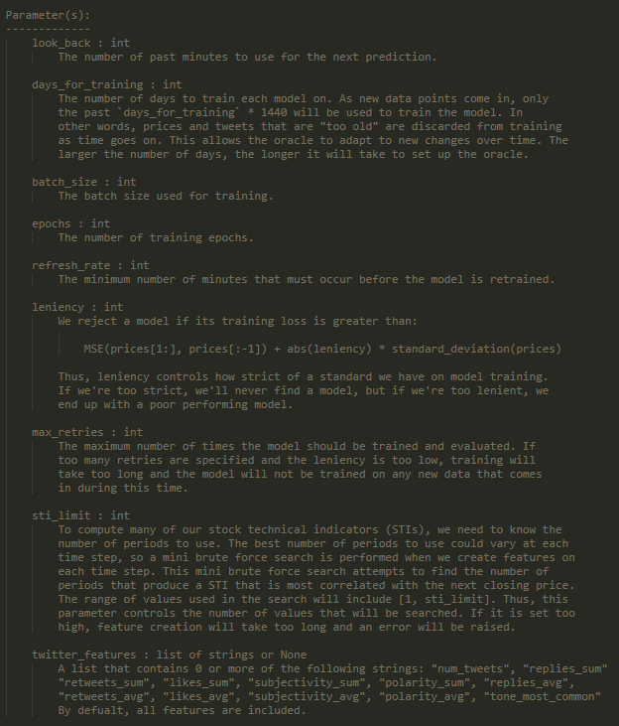
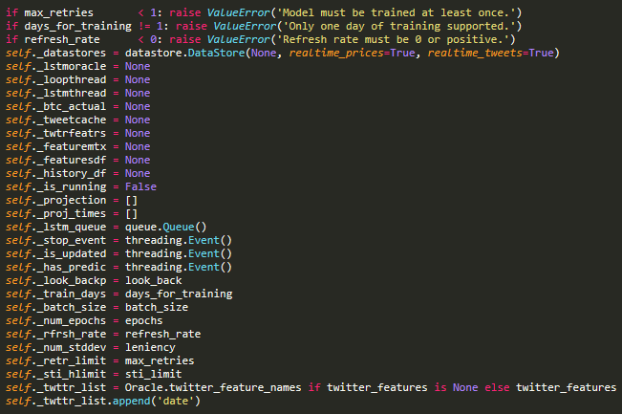
Models Directory
Files
Code Samples
baseline.py
indicator.py
oracle.py
Notes:
Speaker: Chris
Takeaways:
The models folder contains all the models we built
The baseline uses the past price as its only feature
The indicator uses stock indicators
The oracle uses twitter features and stock indicators
On the right here we have the constructor of oracle.py
The constructor is shown just to show you how much stuff we needed to keep track of when running the model - notice that there is a lot so naming and formatting becomes super important
Furthermore, ALL functions that the user is intended to call are documented in detail. Behaviors that will cause an error are mentioned in the docs

Slide 20
Questions that Motivated our Design Choices
Multithreaded
Model Training
Caching
Trimming
How can we train the model frequently but still have it output predictions each minute?
We need to compute a lot of things in under a minute. How can we make sure that no time is wasted doing repeated work?
If we want to use the predictor for a very long time, how can we make sure it’s not eating up all our memory?
Notes:
Speaker: Chris
Now we’ll walk you through some of the questions we had to think about when designing this system
Just as a reminder, our model is retrained on fresh data every 5 - 10 minutes because it offers better predictions. So how is it possible to see predictions on the dashboard during that training time? Our solution was to use a multithreaded training scheme. This means that we use the old model for predictions while the new model is being trained and once the new model is fully trained, we smoothly transition to it and start using it for predictions
Another thing we needed to think about was how can we minimize the time waiting for computations. For minutely predictions EVERY second counts so we needed to be extra careful about not repeating work we’ve already done. To address this issue we wrote code that will cache computations within each minute to prevent any repeated work. And this allows you to get the results you need as fast as possible
The final question we have on our list here concerns memory consumption. The program as a whole needs to work with a lot of data and having it accumulate over a long period of time just slows down other important computations. To remedy this, we have a trimming mechanism so that the oracles are always using the data they actually need. All “old” data is removed from reach and this keeps memory usage constant over time

Slide 21
System Architecture
Data Sources
Trading Signal
Module
Datastore
Module
Tweet
Module
Technical
Indicator
Analyzer
Market
Data
Module
Predictor
Module
Dashboard
24/7 Data
Collector
DB
LSTM
Model
DB
Module
Notes:
Speaker: Chris

Slide 22
Dashboard
04

Slide 23


Notes:
Script (Michela)
I created the dashboard for our project using Plotly’s JupyterDash
JupyterDash is a library that makes it easy to build Dash apps from Jupyter environments
Dash is Plotly’s open source Python framework for building dashboards using pure Python
To aid in the layout of the dashboard, I used dash-bootstrap-components (dbc)
dash-bootstrap-components is a library of Bootstrap components for Plotly Dash that allows for seamless app layouts
Within the code pictured, I set up the Dash app

Slide 24
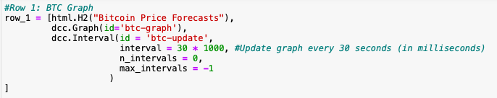
01
Bitcoin Price Forecasts
Notes:
Script (Michela)
First I will explain the code used to create the Bitcoin Price Forecasts chart within the first row of the dashboard
To create this portion of the dashboard, I created an HTML header, a dash core component (dcc) graph element for the Bitcoin price forecasts line/scatter plot, and a dcc interval element
Interval components update your app in real-time without needing to refresh the page or click on any buttons
As the code shows, our interval calls for an update to be made every 30 seconds

Slide 25
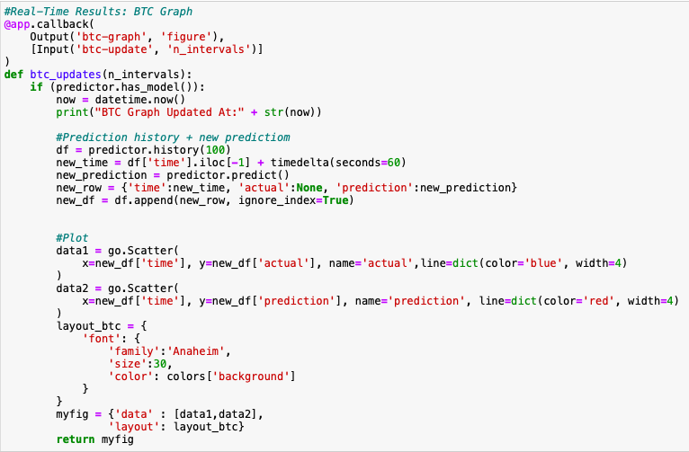
Notes:
Script (Michela)
The following includes a callback decorator and update function for the bitcoin price forecasts graph
Notice how I called the graph and interval id’s defined in the previous slide are within the callback decorator, as this is necessary for dash live updates
Within the code we…
Get a dataframe of the Bitcoin exchange data, which contains all of the actual price values and the predictions made by the model in the past 100 minutes
Add the current prediction for the next minute to the dataframe
Create a scatter/line plot with time as the x-axis and actual Bitcoin exchange rate as the y-axis
Create a scatter/line plot with time as the x-axis and predicted Bitcoin exchange rate as the y-axis
Format the chart’s design
Return a figure that combines the two scatter/line plots and the desired layout

Slide 26
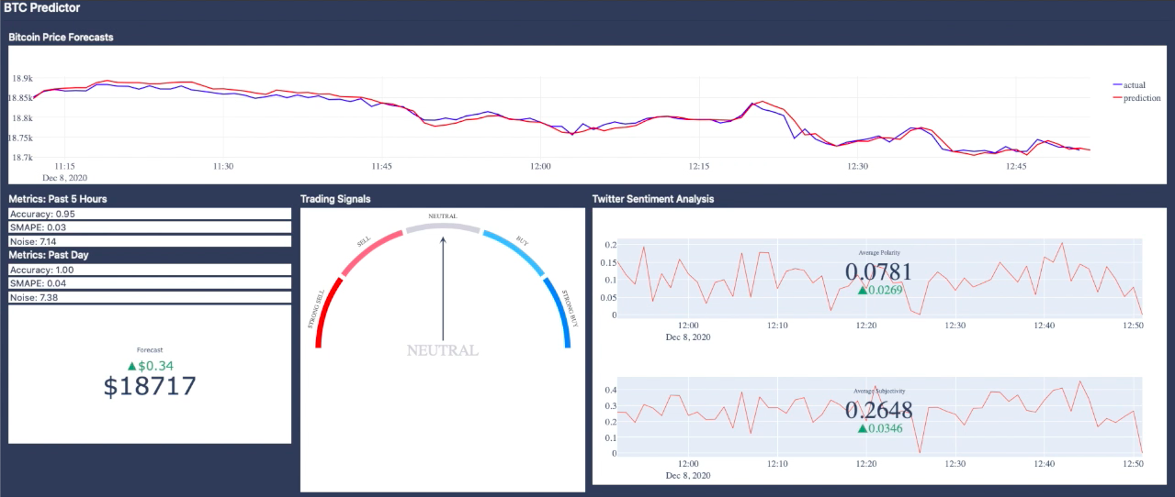
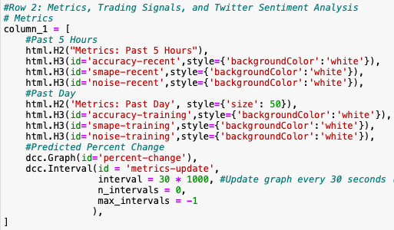
02
Evaluation Metrics
Notes:
Script (Michela)
Next I will explain the code used to create the evaluation metrics text and indicator chart within the second row of the dashboard
To create this portion of the dashboard, I created an HTML header, 6 HTML headers for the evaluation metrics, a dcc graph element for the forecast indicator, and a dcc interval element
As the code shows, our interval calls for an update to be made every 30 seconds

Slide 27
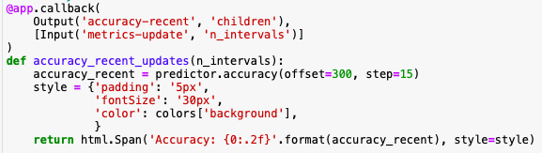
Notes:
Script (Michela)
The following includes the callback decorator and update function for the accuracy for the past 5 hours header object
The code for the other 5 HTML headers is pretty similar, but they use different evaluation metrics and parameters from Chris’ model
Within the code we…
Call Chris’ .accuracy() function with offset set to 300 and step set to 15
This computes the accuracy over the past 300 minutes (i.e. 5 hours) in increments of 15 minutes
Then I define the desired style
And then I return the stylized text for the header object

Slide 28
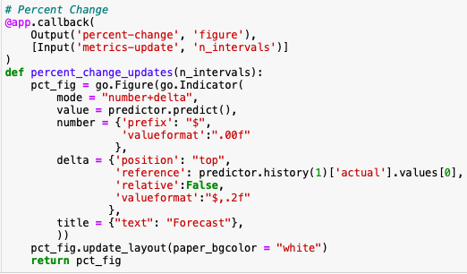
Notes:
Script (Michela)
The following includes the callback decorator and update function for the forecast indicator graph element
Within the code we…
Create a Plotly indicator graph, which visualizes a single value specified by the "value" attribute.
In our case, the “value” we wanted to visualize was the Bitcoin price forecast, which we access with Chris’ model’s predict() function. This is represented by the large number in the Indicator figure.
Then, we define a “delta”, which displays the difference between the “value” with respect to a reference
In our case, we wanted to see how different our Bitcoin forecast for the next minute deviates from the actual price of Bitcoin from the past minute. In other words, how much do we predict the price of Bitcoin is going to increase or decrease within the next minute. This is represented by the smaller green/red text in the Indicator figure.
Then, we return the Indicator figure

Slide 29
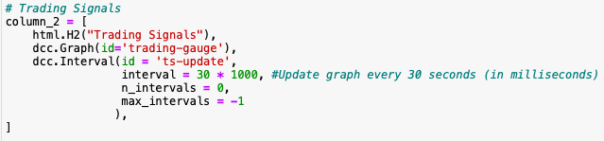
03
Trading Signals Gauge
Notes:
Script (Michela)
Next I will explain the code used to create the trading signals gauge chart within the second row of the dashboard
To create this portion of the dashboard, I created an HTML header, a dcc graph element for the trading gauge, and a dcc interval element
As the code shows, our interval calls for an update to be made every 30 seconds

Slide 30

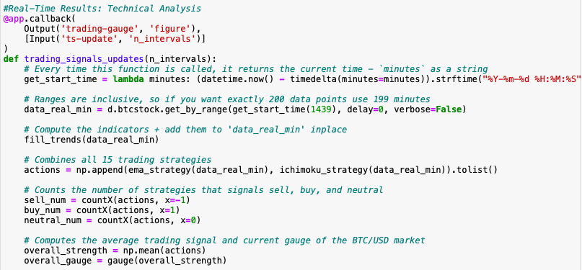
Notes:
Script (Vivian)
The following includes the callback decorator and update function for the trading signals gauge
Within this function, we
First created a helper function get_start_time to help us call the historical Bitcoin exchange rates in minutely granularity
Next, we called the helper functions get_by_range and get_start_time from the btcstock class in the datastore file and extracted historical Bitcoin exchange rates from the past 1440 minutes or 24 hours.
As previously mentioned, this update function is called every 30 seconds in the dashboard
Next, we used a helper function called “fill_trends” which uses a python library called Technical Analysis to help compute the technical indicators that we need for the trading strategies
Then, we called the ema_strategy function and ichimoku_strategy functions which outputs an array of -1, 0, or 1, which represents sell, neutral, and buy, respectively
The results of the trading strategies are then combined
Lastly, we computed the overall strength by taking the average of the array of trading signals
Then we used the gauge helper function to convert the numerical result into a string that ranges from strong sell to strong buy
The picture in the top right corner is an example of what’s being outputted by this update function
In the following slides, I will go over the methods and strategies being called in this update function

Slide 31
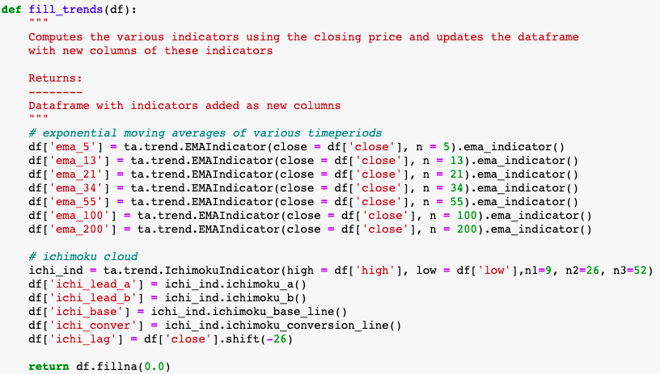
Notes:
Script (Vivian):
First of all, we wrote this fill trends method to compute the technical indicators such as the exponential moving averages of various time periods and the five different ichimoku cloud indicators
We were able to easily accomplish this task using a library called Technical Analysis, abbreviated as ta.
This library is very useful to do feature engineering from financial time series datasets
This is the same method we use to create the features for our LSTM model

Slide 32
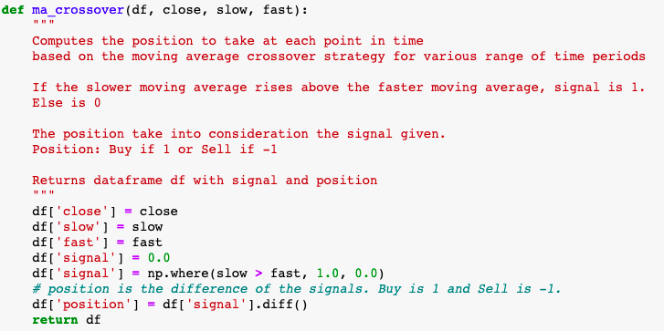
Notes:
Script (Vivian)
As mentioned in the previous slide, one of the strategies used is called the EMA crossover strategy.
EMA stands for Exponential Moving Average, which smooths out the price fluctuations by taking a weighted average of recent prices. It weighs recent prices more heavily.
The crossover strategy uses two moving averages, one with a shorter time period and one with a longer time period.
The moving average with a shorter time period follows the actual fluctuation more closely, while the longer time period smooths out the fluctuations more
The buy signal is triggered when the shorter moving average rises above the longer moving average
The sell signal is triggered when the shorter moving average falls below the longer moving average
This function returns the dataframe with the trading signal at each time step

Slide 33
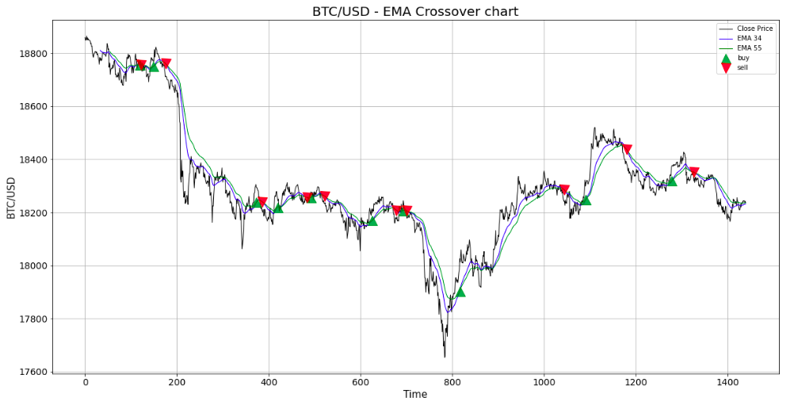
Notes:
Script (Vivian)
To help you better understand what it looks like, I plotted the result of one of the EMA crossovers pairs, with EMA 34 and EMA 55, which smooths out the fluctuation using 34 minutes and 55 minute intervals, respectively
As you can see, when the shorter EMA (blue line) crosses above the longer EMA (green line), the buy signal is triggered. It’s represented by the green triangle in the chart here.
The opposite is true for the sell signal

Slide 34
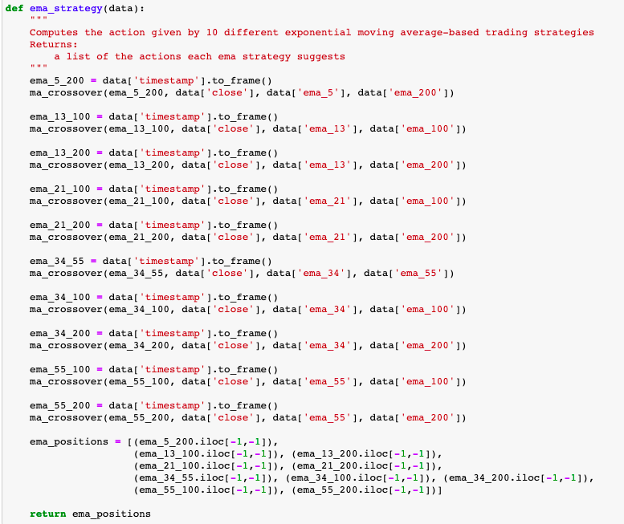
Notes:
Script (Vivian)
This is the ema_strategy function
As you can see, we used created 10 EMA pairs with different combination of the timeperiods
The shorter time periods were chosen using values from the Fibonacci sequence, such as 5, 13, 21, 34, and 55
The longer time periods 100 and 200 are popular values used by technical traders in practice
Within this function, we called the ma_crossover function to compute the trading signal for the 10 EMA pairs
The reason why we used 10 pairs is because EMA is a lagging indicator, which means it doesn’t give you the trading signal at the best time of entrance and exit.
Sometimes the signal is triggered after the momentum already reversed
However, EMA strategy is still a good trading strategy because it is less aggressive and less risky, which is inline with our product’s goal to minimize investor’s risk while making profit during day trade
This function outputs the resulting signals from the 10 strategies as an array. It’s appended with the results from the ichimoku strategy function to get an overall gauge
These 10 strategies outputs trading signal in varying frequency. Thus, it’s highly unlikely all 10 strategies will output the same signal at the same time.
If we have more time, we would change the way we display our technical analysis tool on the dashboard.
Instead of an overall gauge that takes the average of all these strategies, we would display the signals for each individual strategies and display the signals on a chart as shown in the previous slide

Slide 35
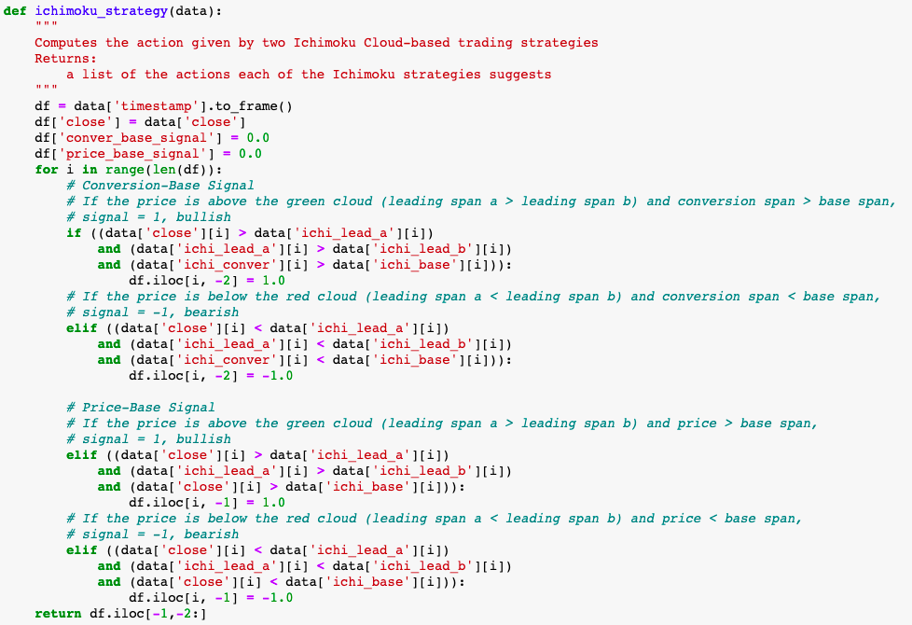
Notes:
Script (Vivian)
The other trading strategy we integrated is based on a popular indicator called the Ichimoku Cloud.
The Ichimoku Cloud is really a set of 5 indicators designed as a standalone trading system. These indicators can be used to identify support and resistance, determine trend direction and generate trading signals.
This function contains two strategies. One is called the conversion base signal strategy and the other is called the price-base signal strategy
Each of these strategies contains three criterias to satisfy in order to trigger either the buy or sell signal

Slide 36
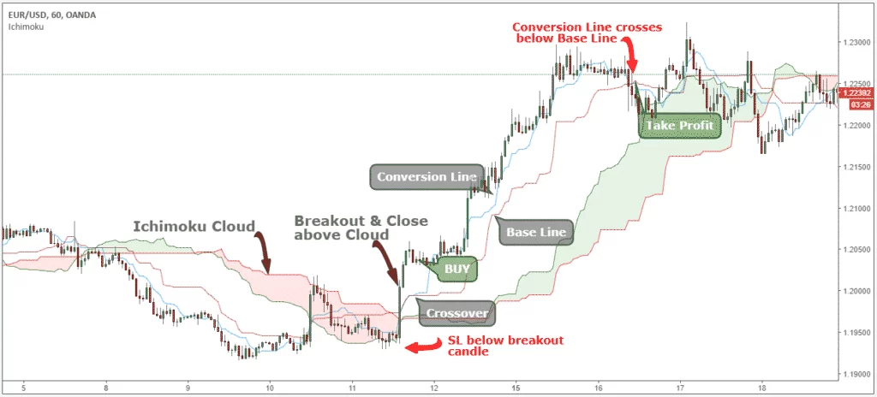
Notes:
Script (Vivian)
For the conversion base signal, if the price is above the green cloud (leading span a is greater than the leading span b) and the conversion span is above the base span, then we have a bullish or buy signal
If the price is below the red cloud (leading span a is less than the leading span b) and the conversion span crosses below the base span, we take our profit and outputs a sell signal
The price-base signal follows a similar idea. If the price is above the green cloud and the price is above the base span, then we have a bullish or buy signal
The opposite is true for the function to output a sell signal

Slide 37
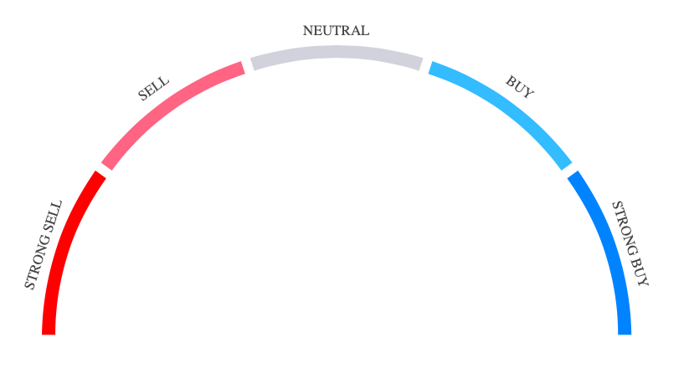
Notes:
Script (Michela)
Within the code we...
The next step is then to demonstrate the results of Vivian’s trading strategies into the gauge chart
The following represents the handmade Plotly graph object I painstakingly created in HTML
In order to create this gauge plot, I had to overlay 2 Plotly pie charts and extremely customize their parameters and HTML

Slide 38
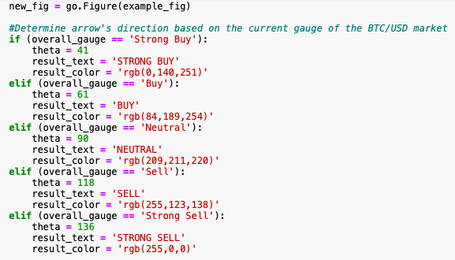
Notes:
Script (Michela)
Within the code we...
We create a copy of the gauge figure explained in the previous slide
Then, based on the result of Vivian’s overall_gauge, we customize the gauge chart
Theta determines the direction the arrow will be pointing
We also determine what the result text will be and its corresponding color

Slide 39
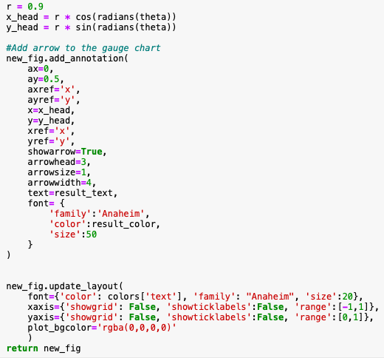
Notes:
Script (Michela)
Within the code we...
We add an annotation to the figure, which add the previously defined arrow and colored text
Define the layout for the figure
Then we return the customized gauge figure

Slide 40
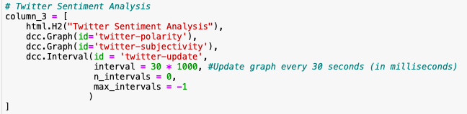
04
Twitter
Sentiment
Analysis
Notes:
Script (Michela)
Finally, I will explain the code used to create the twitter sentiment analysis indicator/line charts within the second row of the dashboard
To create this portion of the dashboard, I created an HTML header, a dcc graph element for the tweet average polarity indicator/line chart, a dcc graph element for the tweet average subjectivity indicator/line chart, and a dcc interval element
As the code shows, our interval calls for an update to be made every 30 seconds

Slide 41
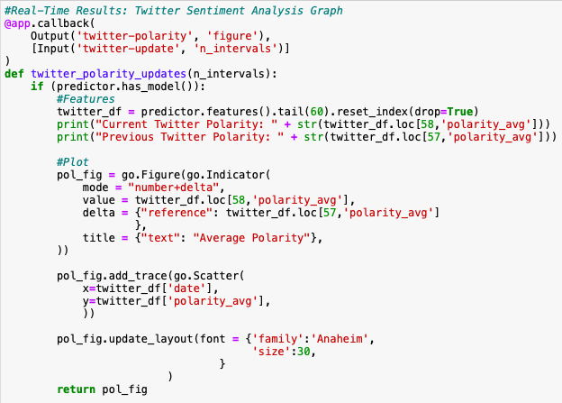
Notes:
Script (Michela)
The following includes the callback decorator and update function for the twitter average polarity line/indicator graph
The code for the twitter average subjectivity line/indicator graph is nearly identical, but it uses the ids and columns for subjectivity instead of polarity.
Within the code we…
Call Chris’ features() function to get all of the features collected by the machine learning model for the past hour
Then, we create an indicator graph, where we showcase the average polarity for tweets within the last minute, and then see how much of an increase or decrease this was from the previous time step’s tweets average polarity
Then, we add a scatter/line plot to demonstrate the change in tweets’ average polarity within the past hour, with time on the x-axis and tweet average polarity on the y-axis
Finally we return the average polarity line/indicator graph

Slide 42
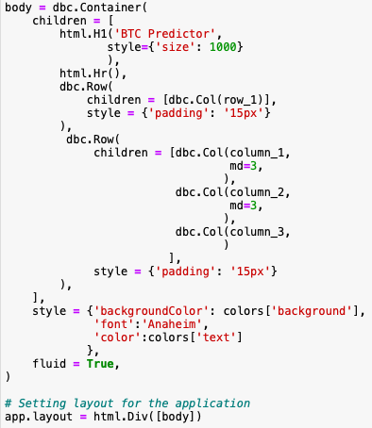

Notes:
Script (Michela)
Finally, we bring all of these elements together within the app’s layout
As the code demonstrates, I used the dash-bootstrap-components (dbc) library to design a clean and organized app layout with rows and columns
Then, the last step is to run the dashboard!

Slide 43
LIVE DASHBOARD TIME
Notes:
-Michela shares screen to share the live dashboard-

Slide 44
How can I try this at home?
Dependencies:
tensorflow==2.3.1
sklearn==0.23.2
plotly==4.9.0
pyrebase==3.0.27
pandas==1.0.1
ta==0.7.0
requests==2.11.1
numpy==1.18.5
jupyter_dash==0.3.1
dash_bootstrap_components==0.10.7
dash_core_components==1.14.1
dash_html_components==1.1.1
dash==1.18.1
fbprophet==0.7.1
textblob==0.15.3
twint==2.1.21

Slide 45
How can I run the demos?
Download required packages
Open the demo of your choosing in a Jupyter Notebook (NOT Google Colab)
Note: OracleDemo.ipynb may show warnings due to our twint dependency and takes a long time to warm up. It is recommended to start with IndicatorDemo.ipynb first.
Run the cells in order and please follow the comments!

Slide 46
How can I run the dashboard?
Download required packages
Open dashboard.ipynb in a Jupyter Notebook (NOT Google Colab)
Note: OracleDemo.ipynb may show warnings due to our twint dependency and takes a long time to warm up.
Run the cells in order up until “Example Usage”
Run the following cell
Run the cell below with predictor.has_model() until the output is True
Run the remaining cells in the notebook
Click the link to the external Dash application

Slide 47
THANKS
Does anyone have any questions?
Please keep this slide for attribution

